Slide 1


Slide 2
Intro to Photo Editing
with Pixlr

Slide 3

Who am I?
Lead Instructor Name
Lead Instructor Bio
@

Slide 4
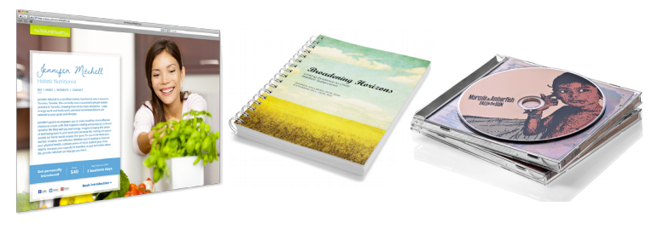
Photo editing was used here, here,
and even here...

Slide 5
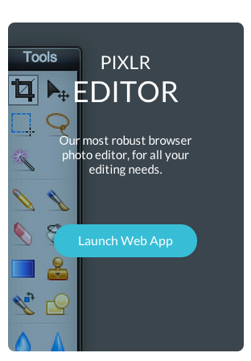
The tool
Pixlr Editor
apps.pixlr.com/editor/

Slide 6
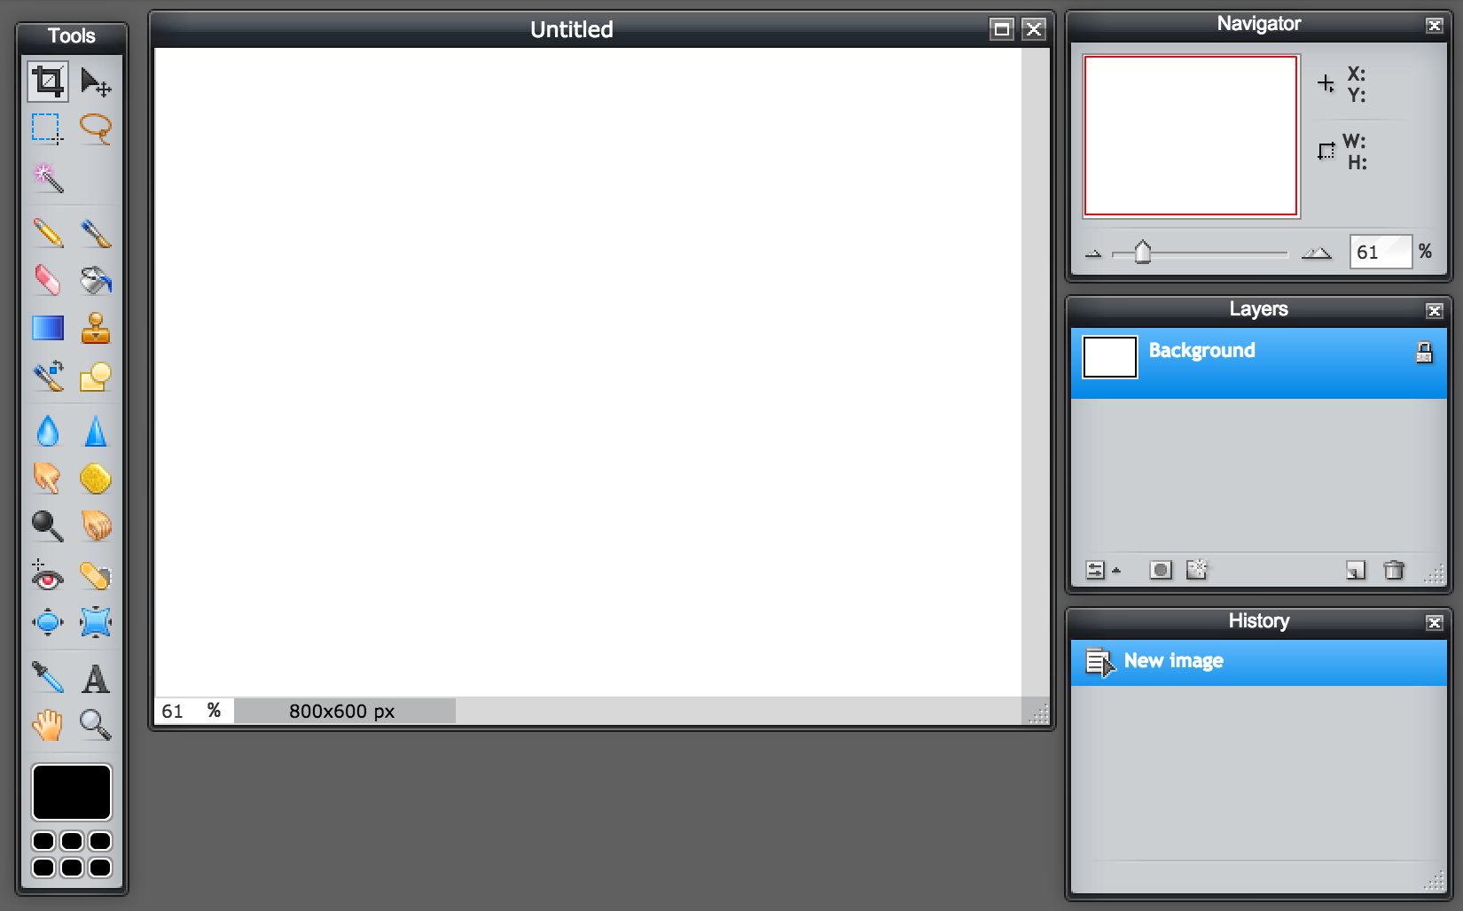
Introducing Pixlr
Tabbed window
Toolbox
Layers
panel

Slide 7


Colour mode
Colour mode for web is: RGB
RBG = Red Blue Green
Colour mode for print is: CMYK
CMYK = Cyan Magenta Yellow Black

Slide 8
Image resolution
The resolution of the image is measured by the number of pixels per inch (ppi)
Ideal resolution for web: 72 ppi (low res)
Ideal resolution for print: 300 ppi (high res)

Slide 9
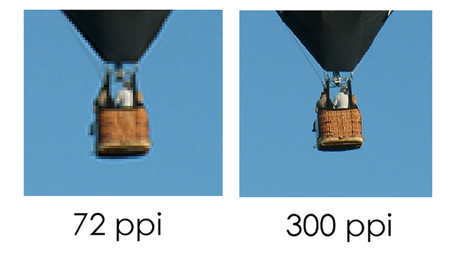
Image resolution
Printed result

Slide 10
Recap
Ideal resolution for web: 72 ppi (low res)
Ideal resolution for print: 300 ppi (high res)

Slide 11
Exercise One
Introducing colour correction, retouching and saving for different outputs

Slide 12
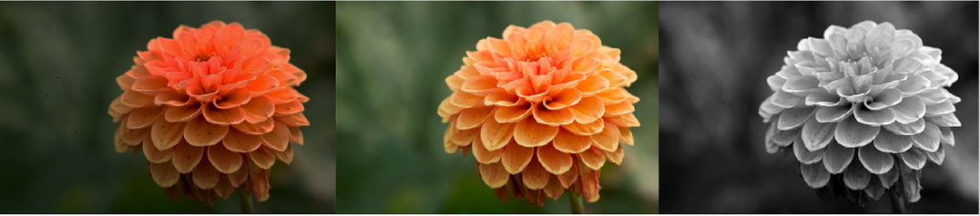
Exercise 1
Before
After (colour)
After (B&W)

Slide 13
Exercise 1
Go to File> Open > Learner Files > Exercise1.jpg
The ‘before’ image should open up
What’s wrong with this image?

Slide 14
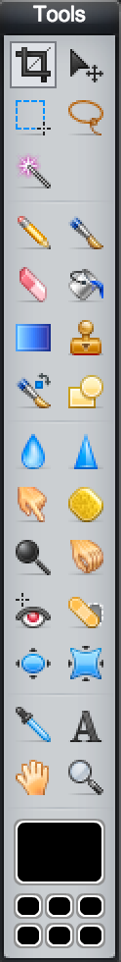
Tools for this exercise
Crop tool
Spot heal tool
Zoom tool
Hand tool

Slide 15
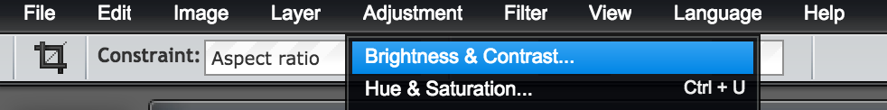
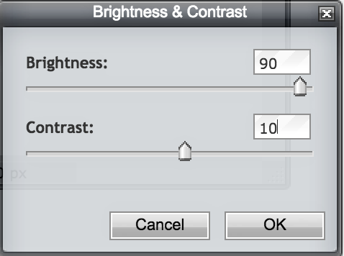
Adjust Brightness/Contrast
Go to image > adjustments > brightness & contrast
Set Brightness to 90 and Contrast to 10
Click OK when done

Slide 16
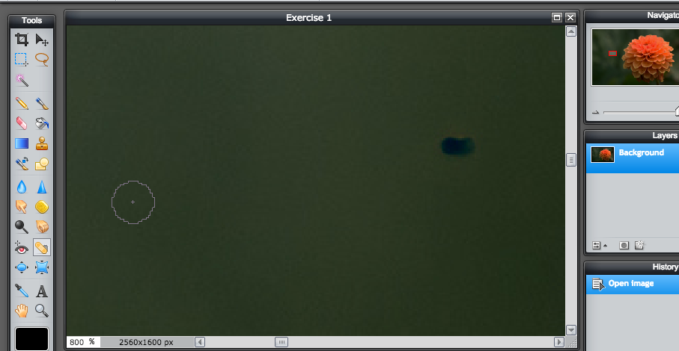
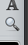
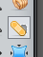
Clean up dark spots
Select Zoom Tool and select one of the dark spots in the background to zoom in
Select Spot Healing Brush Tool. Choose size 20 and Blend Nearby
Paint over the dark spots in the photo to remove them

Slide 17

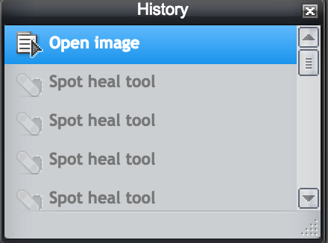
Clean up dark spots
4. Use the Hand tool to move the image around
5. Use the History panel to go back if you make a mistake

Slide 18

Crop image
Select the Crop tool
2. In the control panel at the top, change the width to 6” and the height to 4”
3. Press Enter to crop image.

Slide 19
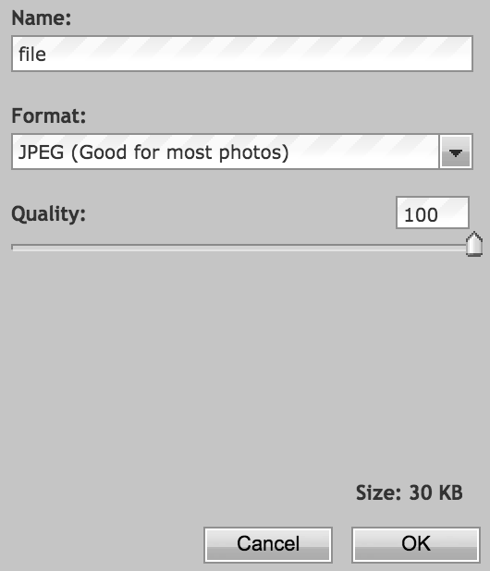
Save for web
Go to File > Save
File format: JPEG
Quality: 100
2. Press Save

Slide 20
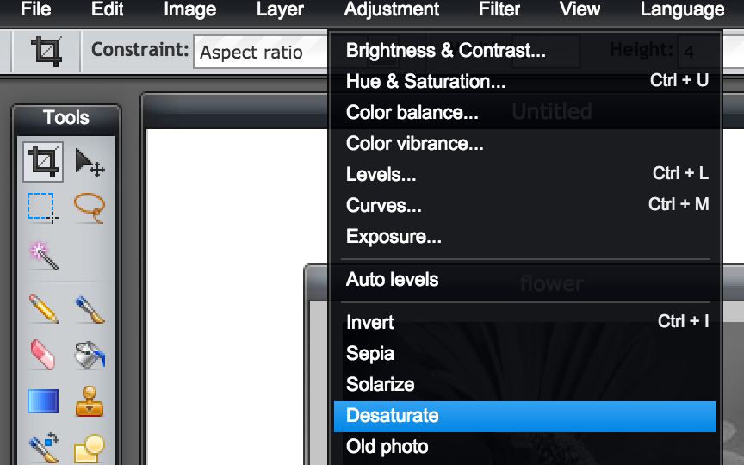
Creating black and white version
Go to Adjustment > Desaturate

Slide 21
Done!
We’re finished! X out of the tab.

Slide 22
Exercise Two
Colour correction, retouching, adjustment layers and masking.

Slide 23
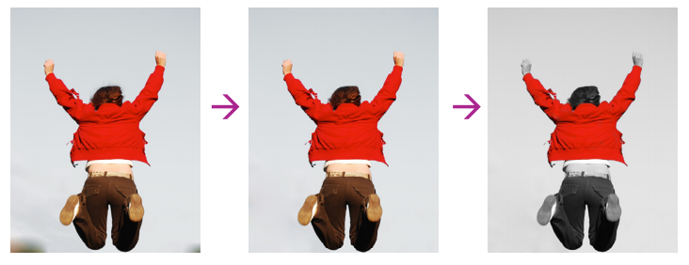
Exercise 2

Slide 24
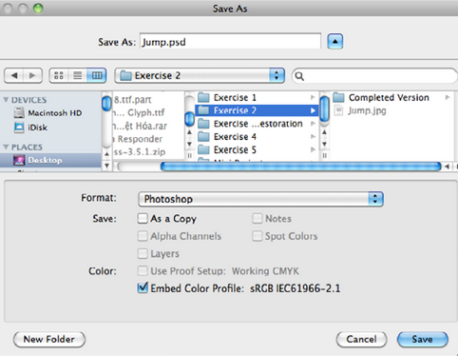
Exercise 2
Open Exercise 2.jpg
Go to File > Save as

Slide 25
Tools for this exercise
Crop tool
Brush tool
Zoom tool
Hand tool
Foreground colour

Slide 26
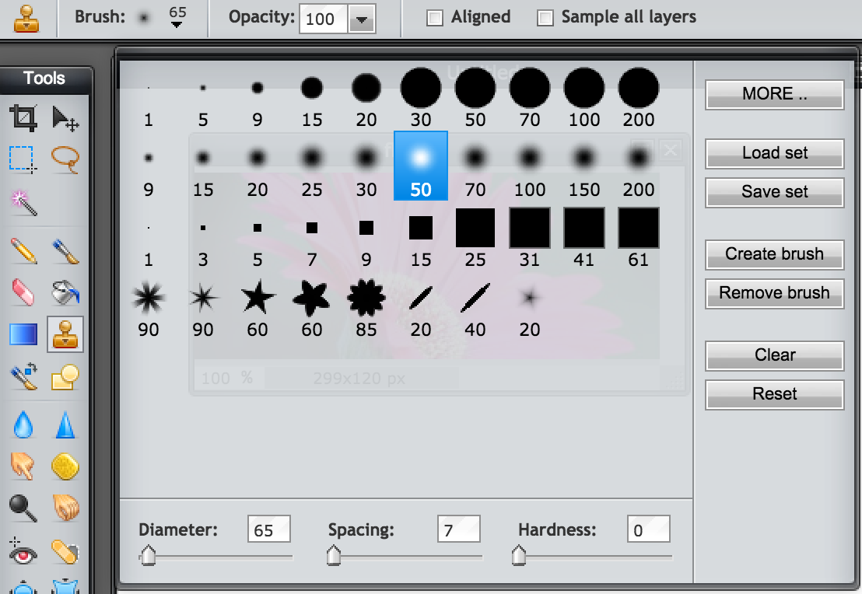

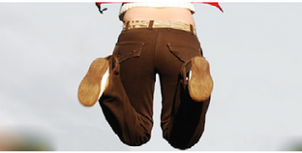
Retouching: Removing Shadows
Select Clone Stamp tool
Set size to 65 pixels and hardness to 0
Hold down the alt/option key to click on a clean spot well above the left shadow to sample that area
Paint over the shadow to remove it

Slide 27
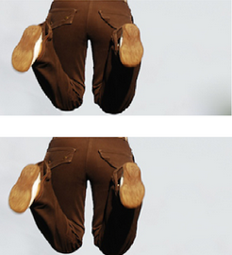
Retouching: Removing Shadows
5. Hold down the alt/option key and click on the clean spot well above the right shadow to sample the area
6. Paint over the shadow area

Slide 28
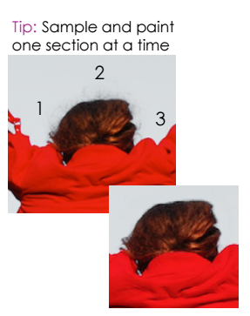
Retouching: Removing fly away hairs
Click on the Zoom Tool and click on her head until you zoom in 400%. Use the hand tool if you need to move around
Click on the Clone Stamp Tool. Set size to 10 pixels and hardness to 70%
Click on a spot above her head and paint over the fly away hairs

Slide 29
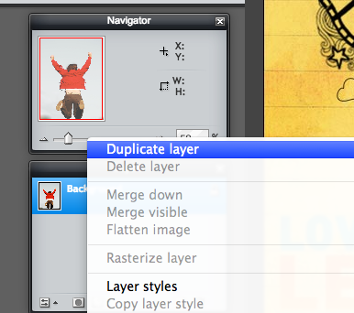
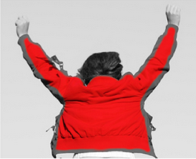
B&W with a splash of colour
Right click on the base layer and duplicate.
Go to Adjustment > Desaturate on the top layer

Slide 30
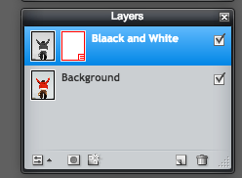
B&W with a splash of colour
layer mask thumbnail
layer visibility

Slide 31
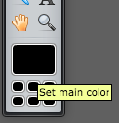
B&W with a splash of colour
3. Select Brush Tool
4. Set black as the mail colour in the tool bar

Slide 32
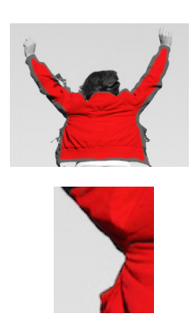
B&W with a splash of colour
5. Paint over everything but the jacket to reveal the black and white.
6. Zoom in and use a smaller brush to paint the edges
7. Right-click to adjust the size and hardness of the brush as needed
Tip: Instead of undoing changes use the eraser tool to re-apply black and white

Slide 33
Save for web
Go to File > Save
File format: JPEG
Quality: 100
2. Press Save

Slide 34
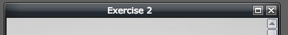
Done!
We’re finished! X out of the tab.

Slide 35
Exercise Three
Practicing retouching skills, adjustment layers and masking

Slide 36
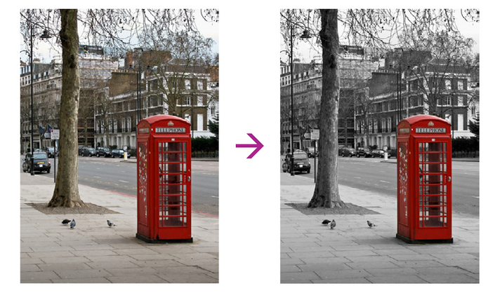
Exercise 3

Slide 37

Exercise 3
Open Exercise 3.jpg

Slide 38
Tools for this exercise
Brush tool
Clone stamp tool
Spot heal tool
Zoom tool
Hand tool

Slide 39
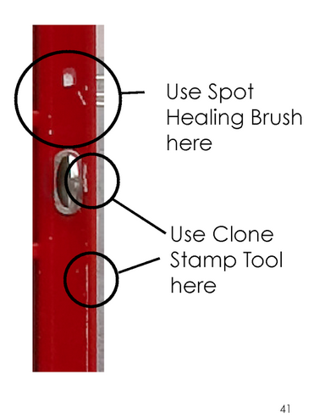
Retouching: Let’s clean it up!
Use your Spot Healing Brush and Clone Stamp Tool to remove imperfections on the side of the door. Use a small, soft brush and work your way down the side of the door.
Remember: You must select a sample through alt/option for the Clone Stamp. Spot Healing automatically samples.

Slide 40
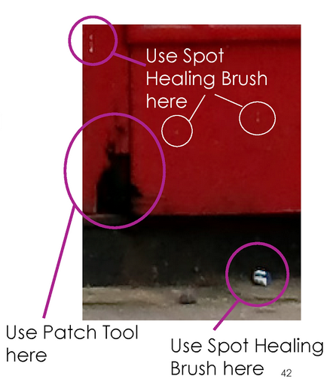
Retouching: Let’s clean it up!
2. Use your Spot Healing Brush and Clone Stamp Tool to remove imperfections on other parts of the door. Change your tool and size/hardness accordingly. It will take some experimenting and that’s OK.
Remember: Use your history panel to undo any mistake. Take note it only records the last 20 changes though!

Slide 41
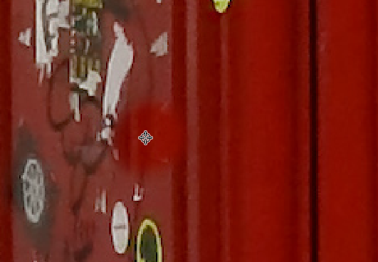
Retouching: Using the Clone Stamp Tool
Select the Clone Stamp Tool
Select an area around a sticker
Select an area you’d like to clone by selecting Command/Ctrl + click
Move your brush over the area you’d like to retouch

Slide 42
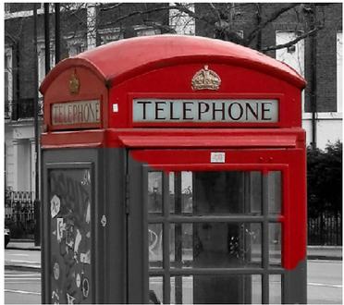
B&W with a splash of colour
Right click on the base layer and duplicate.
Go to Adjustment > Desaturate on the top layer
Click the Eraser tool and start erasing over the red colour
Zoom in if you have to.
Adjust hardness and size accordingly

Slide 43
Save for web
Go to File > Save
File format: JPEG
Quality: 100
2. Press Save

Slide 44
Done!
We’re finished! X out of the tab.

Slide 45
Exercise Four
Use retouching skills to restore old photographs

Slide 46
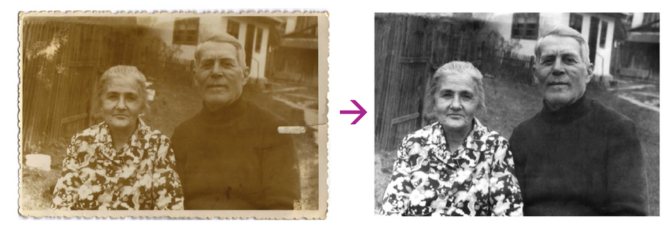
Exercise 4

Slide 47
Exercise 4
Open Exercise 4.jpg
Go to File > Save
Rename it as Photo Restoration

Slide 48
Tools for this exercise
Lasso tool
Brush tool
Clone stamp tool
Dodge tool
Spot heal tool
Zoom tool
Hand tool

Slide 49
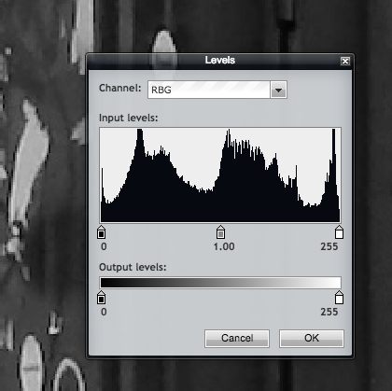
Tonal adjustment
Go into Adjustment > Desaturate
Click OK when done
Go to Adjustment > Levels
Use the eyedropper tools to set the black and white points of the photo, then manually adjust the stops as needed
Click OK when done

Slide 50
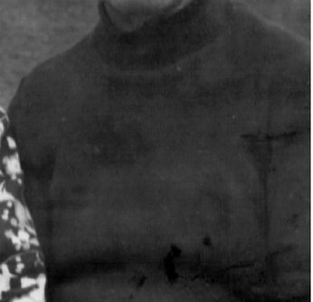
Touch up the sweater
Zoom into the man’s sweater
Select the Spot Healing tool and set the size to 83 pixels and hardness to 0
Clean up the minor damage on the sweater

Slide 51
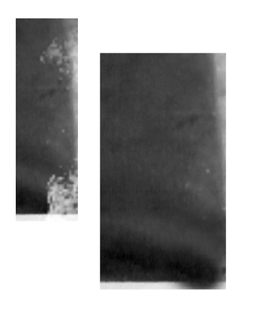
Touch up the sweater
4. Zoom in and use the Clone stamp tool to fix the damage on the arm
It’s okay if you paint past the border- we’re cropping this later
Reminder: Save things as you go!

Slide 52
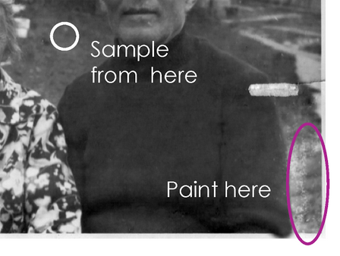
Touch up the background
Use the Clone Stamp tool to sample the background area between the man and the woman and then paint the damaged area next to the man’s arm
Note: Since the damaged area is much longer than the sample area, you will have to sample/paint a few times.

Slide 53
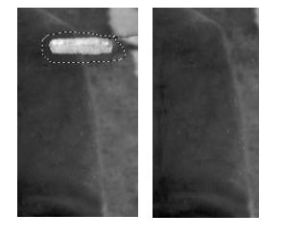
Fix the rip
Use the Clone Stamp tool to sample an area of the t-shirt
Note: Since the damaged area is much longer than the sample area, you will have to sample/paint a few times.

Slide 54
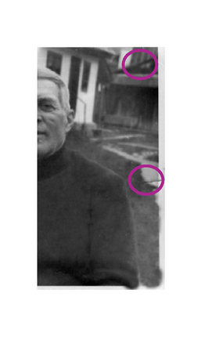
Minor damage
Zoom in and use the Clone Stamp tool to fix the damage on the right side of the photo.
Use the Spot Healing tool to clean up any other minor spots in the photo, including the fence. We’ll do the major fence damage next!

Slide 55
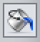
Restore the fence
Zoom into fence
Use the Lasso tool to draw an outline around the first section of damage
Sample the colour and fill it in using the Bucket tool

Slide 56
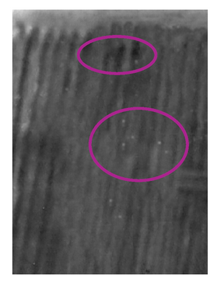
Restore the fence
Repeat the process with the two other damages. You may have to fill it in more than once to make it look natural.
Clean up any remaining spots with the Spot Healing tool or the Clone Stamp tool

Slide 57
Restore the fence
Select the Dodge Tool
Set the size to 140px and hardness 0%
In the control panel set the range to Shadows and and Exposure to 6%

Slide 58
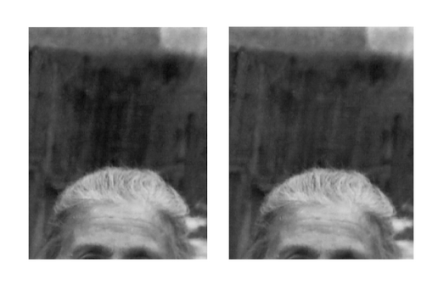
Restore the fence
Paint the very dark area over the woman’s head until the tones are more consistent with the rest of the fence
Clean up any remaining spots on the fence with the Spot Healing tool or the Clone Stamp Tool

Slide 59
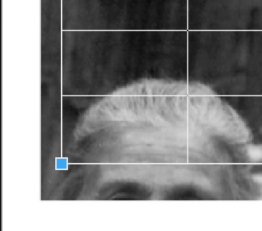
Crop and save your file
Select the crop tool
Drag edges slightly inside the image area to crop out the border
Press Enter when satisfied

Slide 60
Done!
We’re finished! X out of the tab.

Slide 61
Exercise 5
Use layers, masks and filters to create a stylized composition

Slide 62
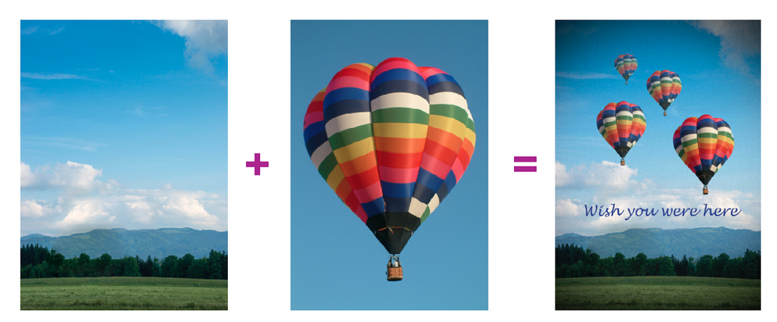
Exercise 5

Slide 63
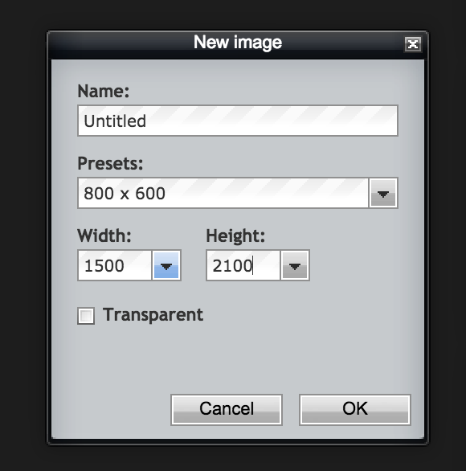
Getting set up
Go to File > Image
Set the width to 1500 and the height to 2100

Slide 64
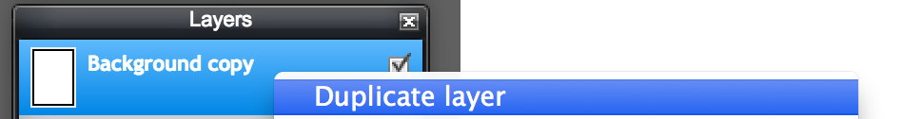
Bringing in the background
Go to File > Open > Exercise5a.jpg
Right click on the background layer to reveal options
Select Duplicate layer. Name the layer ‘Background’

Slide 65
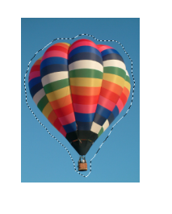
Bringing in the hot air balloon
1. Open Exercise 5b.jpg
2. Select the Lasso Tool and draw an outline around the hot air balloon, careful not to cut it off
3. Go to Edit > Copy
4. Return to your Background document
5. Go to Edit > Paste

Slide 66
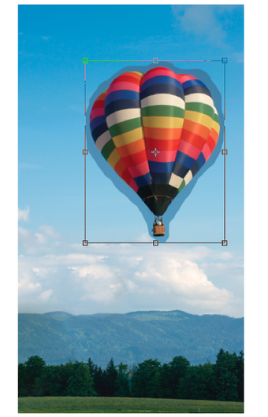
Editing the hot air balloon
Go to Edit > Free Transform
While holding Shift, click and drag the corner until the balloon is a realistic size.
Reminder: Save your work!

Slide 67
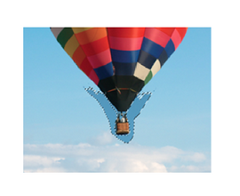
Editing the hot air balloon
3. Select Magic Wand Tool
4. Set the Tolerance to 40
5. Click on the background above the hot air balloon and delete
6. Lower the tolerance control panel to 10
and repeat for the lower part of the balloon

Slide 68
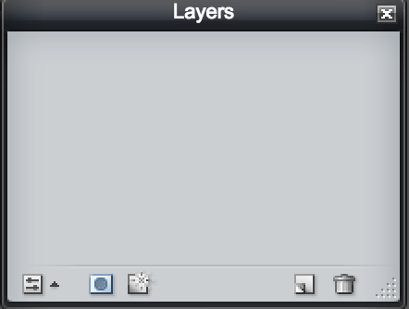
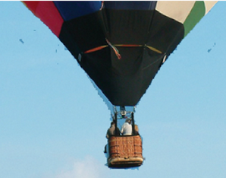
Editing the hot air balloon
7. Click on the Add Layer Mask icon at the bottom of the layer panel.
8. Select the Brush tool and set the foreground colour to black.
9. Paint over the remaining background areas of the hot air balloon to hide them.

Slide 69

Duplicating the hot air balloon
Rename your hot air balloon layer to stay organized
Right click on the layer and select Duplicate layer
Name the new layer Balloon 2
Reposition it

Slide 70

Duplicating the hot air balloon
5. Go to File > Free Transform
While holding down the Shift key, click and drag the corner until the balloon is about two thirds the size of the original to give the impression of distance.

Slide 71

Duplicating the hot air balloon
Repeat steps 2-5 to create balloon 3 and 4, each one smaller than the last.
Reminder: save your work!

Slide 72


Changing the opacity
Click on the Balloon 2 layer in your layer panel
Change the opacity to 90%
Click on the Balloon 3 layer and change the opacity to 80%
Click on the Balloon 4 and change opacity to 60%

Slide 73

Using the type tool
Click on your Horizontal Type Tool
Click on desired location
Select a font, size and colour and type your text.

Slide 74
Save!
Right click on a Layer and click Flatten Image
Save the image by going to File > Save as Postcard

Slide 75

Create a vignette
Go to Filter > Vignette
Set Vignette Amount to 10 (or desired preference) and main color to white
Click OK

Slide 76

Add a grainy texture
Go to Filter > Noise
Change to desired amount and click OK

Slide 77
Save for web
Go to File > Save
File format: JPEG
Quality: 100
2. Press Save

Slide 78
Done!
We’re finished! X out of the tab.

Slide 79
Final Exercise!
Tyrannosaurus Photo bomb!

Slide 80

Exercise 6

Slide 81


Adjustments on the background
Open Exercise6a.jpg
Click Adjustments > Hue/Saturation, set Saturation to +40
Adjustments > Brightness/Contrast, set Brightness to +20

Slide 82

Bringing in the couple
Open Exercise6b.jpg
Use the Lasso tool to draw an outline around the couple. Be careful not to cut them off
Edit > Copy
Go back to the original document and Copy > Paste

Slide 83

Editing the couple
Resize the couple
Edit > Free transform
Hold down the shift key and drag the corner of the image
Add a layer mask to the couple

Slide 84
Editing the couple
3. Reveal the couple by painting with a black brush.
Tip: Use a large/hard brush to hide areas that aren’t touching the couple. Then zoom in and use a smaller/softer brush to hide the areas very close to the end. Use the erase tool to re-reveal the background

Slide 85

Editing the couple
4. Click on the thumbnail of the couple in the layer panel
5. Adjust the couple to match the background, Adjustments >
Hue/Saturation- Set Saturation to +20 and Hue to +6
Brightness/Contrast- Set Contrast to +20

Slide 86

Bringing in the Tyrannosaurus
Layer > Open image as layer
Select Exercise6c.jpg

Slide 87

Removing the white background
4. Cut the selection by pressing delete
5. Most of the selection should be gone, if not, erase it manually
6. Continue using the Magic Wand tool to remove the rest of the background around the feet

Slide 88

Colour correcting the T-rex
Click on the Adjustment > Hue/Saturation
Set the Hue as +2,
Saturation as +25
Lightness as +2

Slide 89



Sharpen the face
Select the Sharpen tool
Change the size to 100 and the Hardness to 0
Set strength to 0%
Paint over face to sharpen it

Slide 90

Blend feet into grass
Add a layer mask to the dinosaur layer
With black brush, paint the edges of the T-rex’s feet so he no longer appears to be floating on grass
Size: 30
Hardness: 30%

Slide 91


Add a shadow
Select the Burn tool
Set exposure in the panel to 30
Select the background layer in the layer panel. Now paint the grass beneath the dinosaur’s feet to make it darker.

Slide 92

And we’re done!

Slide 93


End of day activities
Create your own photobomb! Replace the couple or put the Tyrannosaurus you just edited into your own photo
Restore an old photo if you brought one
Work on one of the mini projects in the Extras folder located in your Learner files

Slide 94


